Slide 1


Hyperledger Expert
Sriram
Technology of Trust

Slide 2


Hyperledger Expert

Slide 3
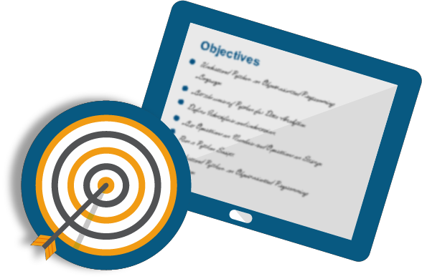
Objectives
After completing this module, you should be able to:
Comprehend the Hyperledger project
Infer the Hyperledger architecture
Explore the consensus mechanism in Hyperledger
Landscape - Four major Hyperledger frameworks

Slide 4
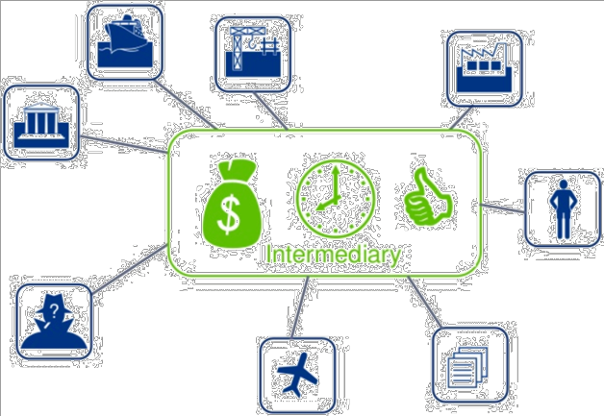
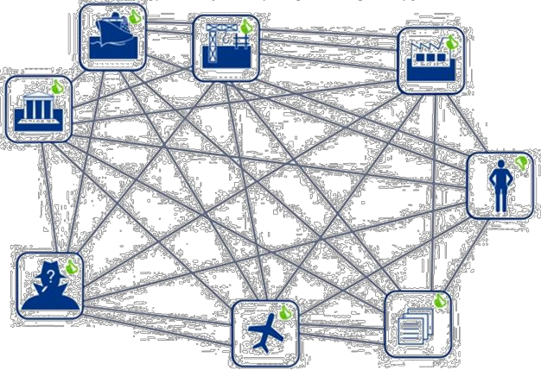
Business Network- Traditional v/s Blockchain
Business Network - A traditional view
Business Network - The blockchain view

Slide 5
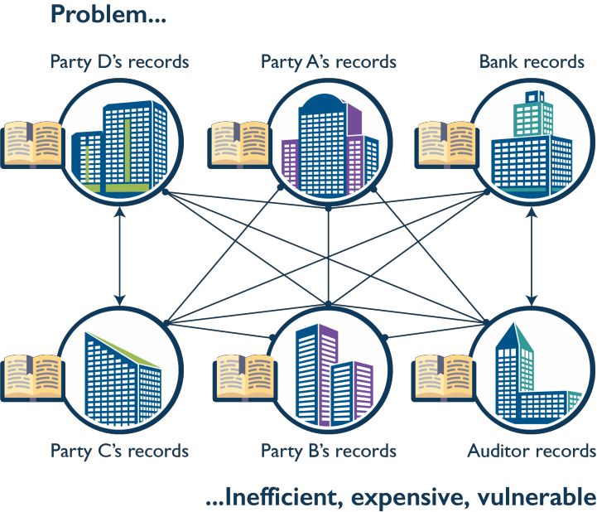
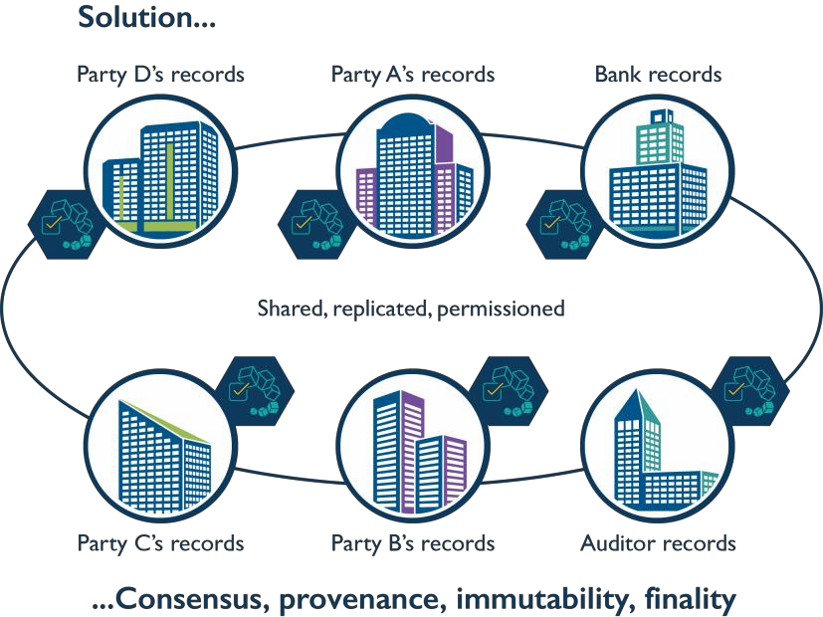
Traditional v/s Blockchain Business Network

Slide 6
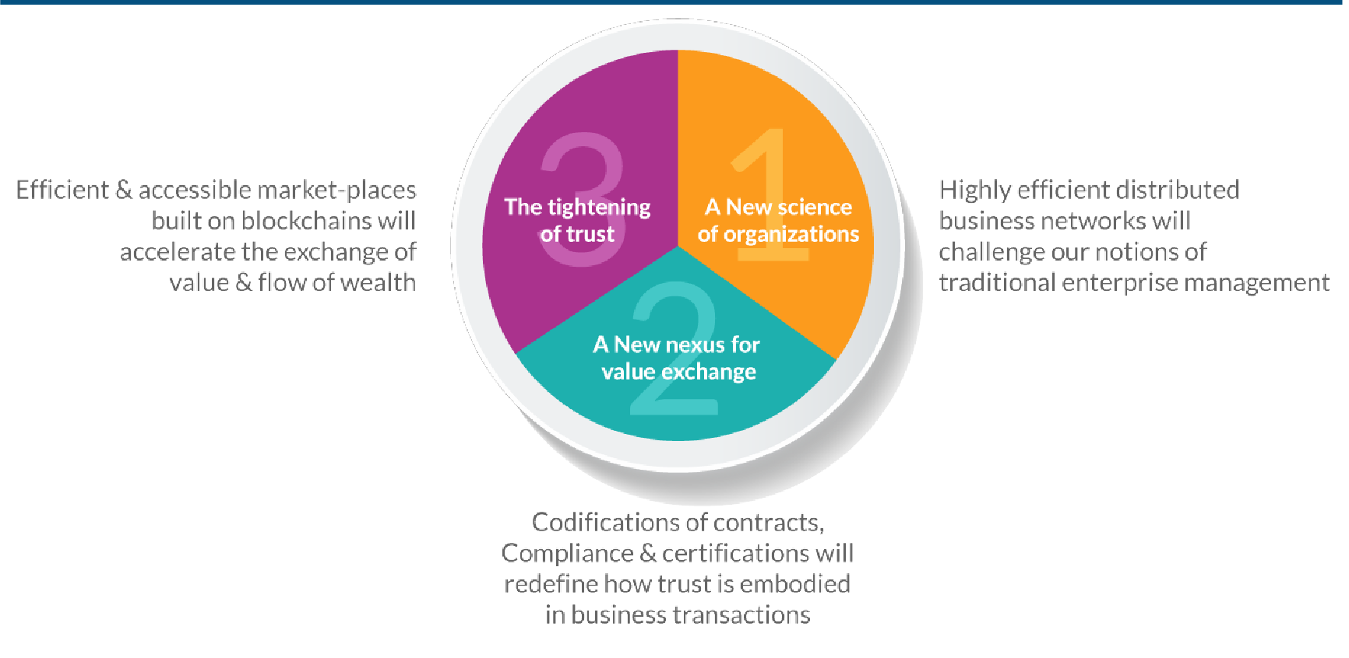
Blockchain will Change the way we do Business

Slide 7
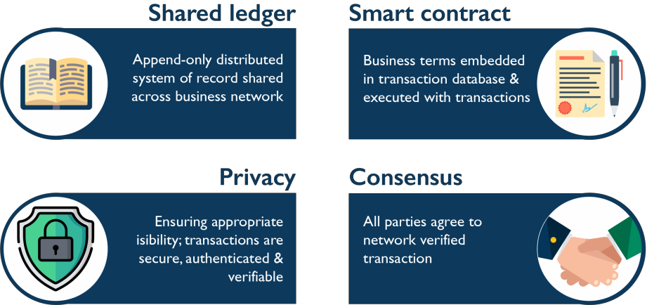
What is Blockchain for Business?
It’s the combination of a shared, unalterable ledger and smart contracts that streamline business processes and open new opportunities for innovation
Consensus among blockchain network members eliminates costly risks and inefficiencies as assets change hands throughout a business network
This enterprise-ready blockchain platform makes it easy to activate and manage a secure business network across multiple organizations
visibility;

Slide 8
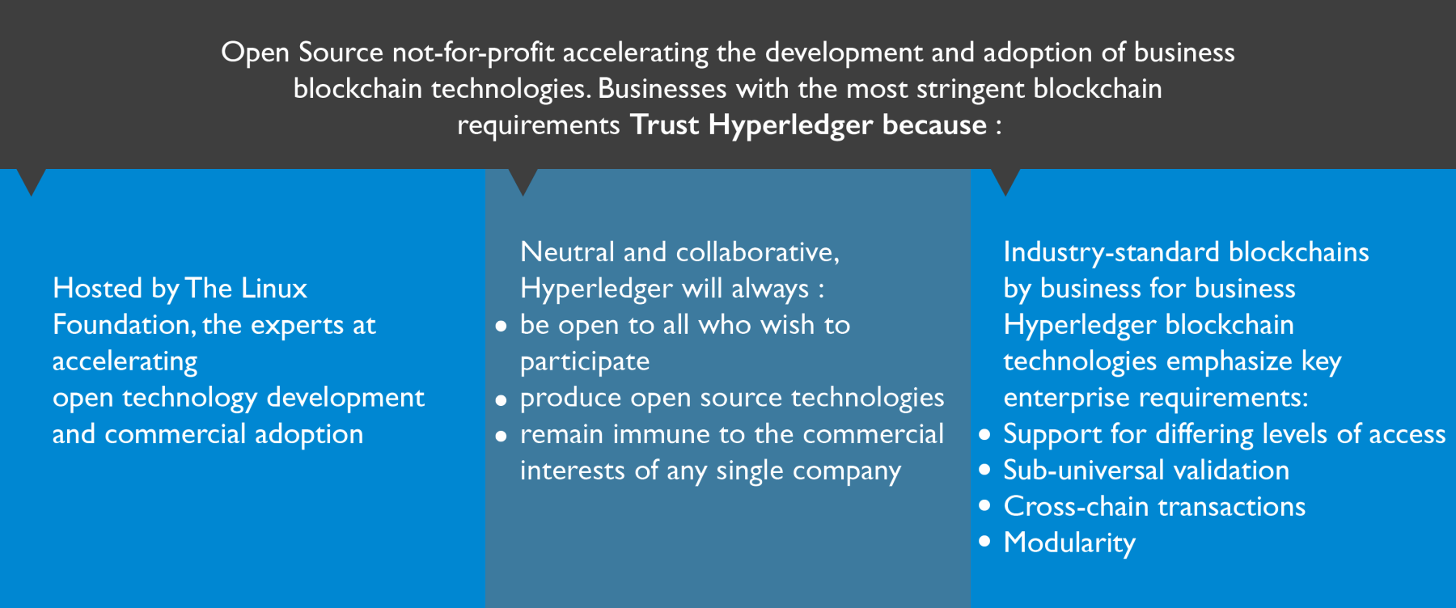
What is Hyperledger?
Hosted by the Linux Foundation, the experts at accelerating open technology development and commercial adoption
Be open to all who wish to
participate
Produce Open Source Technology
Remain immune to the commercial interest of any single company

Slide 9












Unique Advantages of Hyperledger Fabric
Permissioned
membership
Rich queries over an
immutable distributed ledger
Performance, scalability, and levels of trust
Modular architecture supporting plug-in components
Data on a need-to-
know basis
Protection of digital keys and sensitive data

Slide 10


Hyperledger Goals
01
02
03
04
Create an enterprise grade, open source distributed ledger framework & code base, upon which users can build and run robust, industry-specific applications, platforms and hardware systems to support business transactions
Build an open source, technical community to benefit the ecosystem of Hyperledger solution providers and users, focused on blockchain and shared ledger use cases that will work across a variety of industry solutions
Promote participation of leading members of the ecosystem, including developers, service and solution providers and end users
Host the infrastructure for Hyperledger, establishing a neutral home for community infrastructure, meetings, events and collaborative discussions, & providing structure around the business and technical governance of Hyperledger

Slide 11
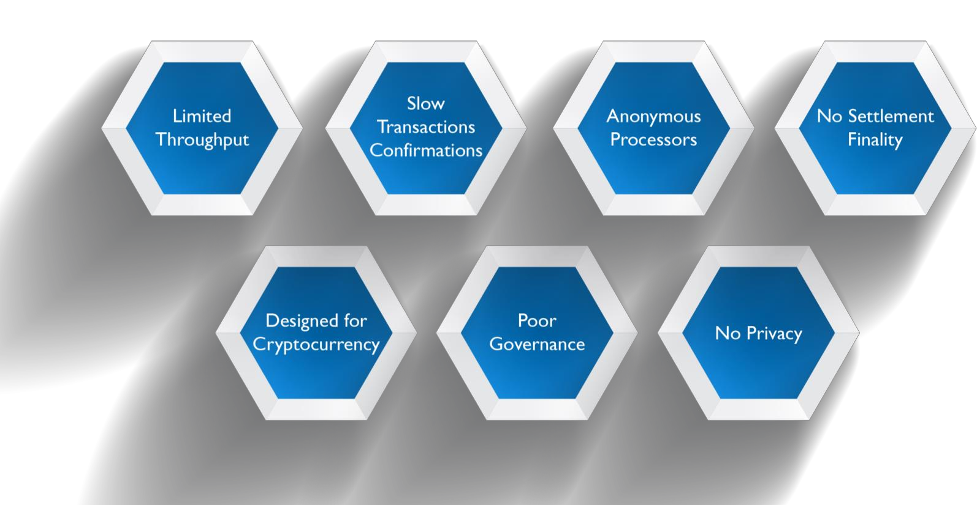
Problems with Existing Blockchains

Slide 12







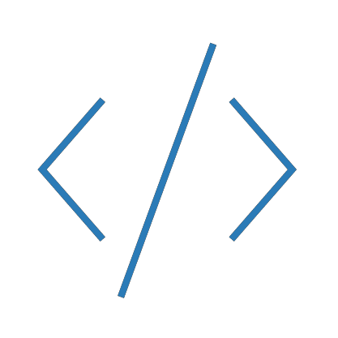


Hyperledger Goals
Create enterprise grade, open source, distributed ledger frameworks and code bases
to support business transactions
Provide neutral, open, and community-driven infrastructure supported by technical and business governance
Build technical communities to develop blockchain and
shared ledger POCs, use cases, field trails and deployments
Educate the public about the market opportunity for blockchain technology
Promote participation of leading members of the ecosystem, including developers, service and solution providers and end users

Slide 13
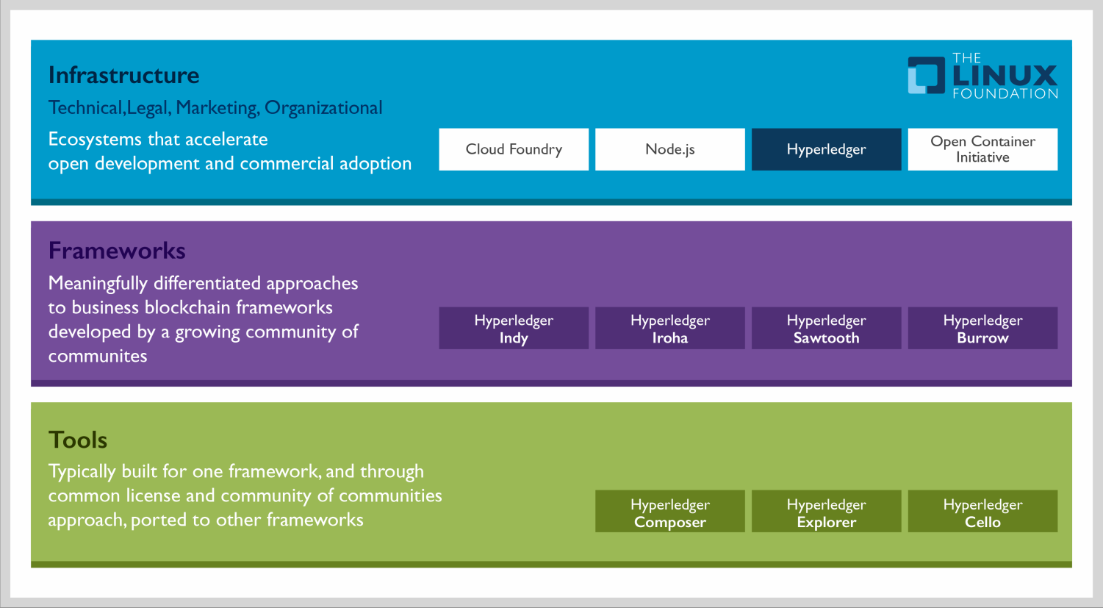
Hyperledger Modular Umbrella Approach

Slide 14
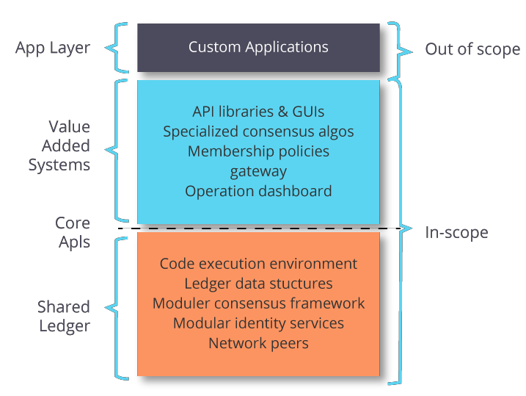
Hyperledger Project Scope

Slide 15

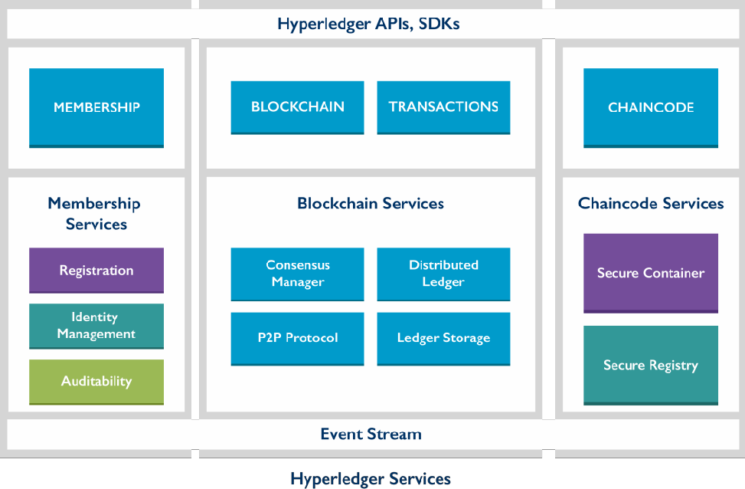
Hyperledger Architecture
Hyperledger reference architecture is aligned in three categories: Membership, Blockchain and Chaincode
These categories are a logical structure, not a physical depiction of partitioning of components into separate processes, address spaces or (virtual) machines

Slide 16

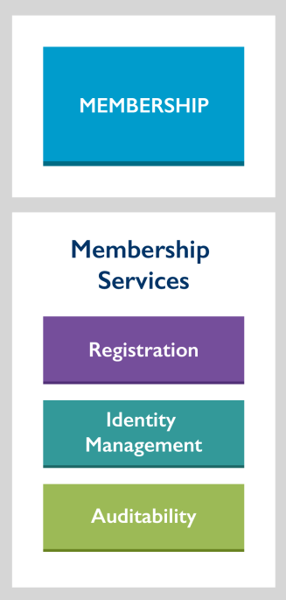
Hyperledger Architecture - Membership
Hyperledger is a private validator network protocol, so all entities are required to register with membership services to obtain an identity with access and transaction authority on the network
Registration service: offers the control and management of authorizations for Hyperledger participation
Identity Management service: provides the management of assurance and authorized
disclosure of association of identities and roles to Hyperledger participants
Auditability service: offers the capability to provide authorized entities with the means to link transactions of individual users, or groups of users according to affiliations, and to access the activity of a particular user of the system, or the operation of the system

Slide 17

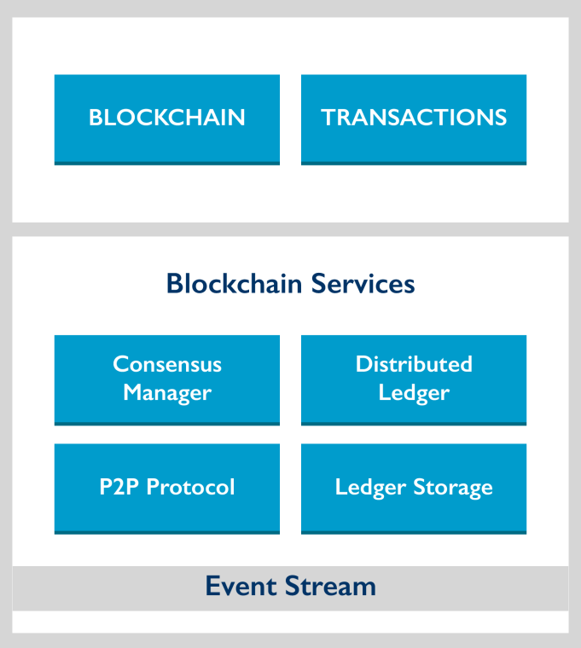
Hyperledger Architecture - Blockchain
Blockchain services consists of three key components: P2P Protocol, Distributed Ledger & Consensus Manager
It manages the distributed ledger through a p2p protocol, built on HTTP/2
The data structures are optimized to provide efficient schemes
for maintaining the world state replicated at many participants
Different consensus algorithms may be plugged in and
configured per deployment

Slide 18

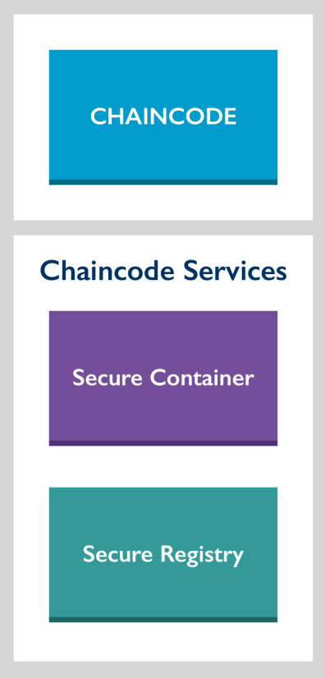
Hyperledger Architecture - Chaincode
A piece of code that lets you interact with a network’s shared ledger
Whenever a transaction is invoked on the network, a function in a piece
of chaincode is called that reads and writes values to the ledger
Chaincode services uses Docker to host the chaincode

Slide 19
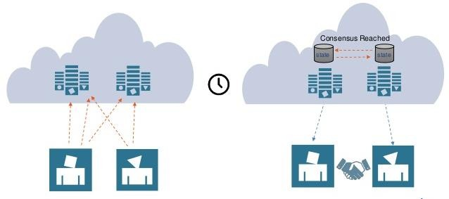
Consensus in Hyperledger
Consensus algorithms under the Hyperledger protocol must be pluggable, allowing users to select the consensus algorithm of their choice during deployment
The Hyperledger protocol provide an implementation of Byzantine Fault Tolerance (BFT) in its initial release,
using the PBFT protocol

Slide 20
Generalized Hyperledger Consensus Process Flow
Consensus
Client Consensus Smart Contract
Transactions are delivered into the pending pool Transactions are selected from the pending pool
(on other peers)
Transactions sent for application Speculatively apply the transactions
Return a proof of correctness and/or change set
alt
[If transactions have been successfully applied]
Order transactions
Broadcast ordered list of transactions, the proof of correctness, and the change sets Send requests
Verify transactions deterministically
Return corrected block of transactions
Commit block of transactions
Notify clients of events (if any)

Slide 21
Consensus & its Interaction with Architectural Layers
Hyperledger business blockchain frameworks reach consensus by performing two separate activities:
Ordering of transactions
Validating transactions
01
Ordering:
Consensus depends on an ordering service to order transactions. To enable confidentiality of the transactions, the transaction content can be
hashed or encrypted
Validating:
To validate transactions, consensus depends on the smart contract layer because it contains the business logic behind what makes a transaction valid.
02
By logically separating these activities, we ensure that any Hyperledger framework can work with any
Hyperledger consensus module

Slide 22
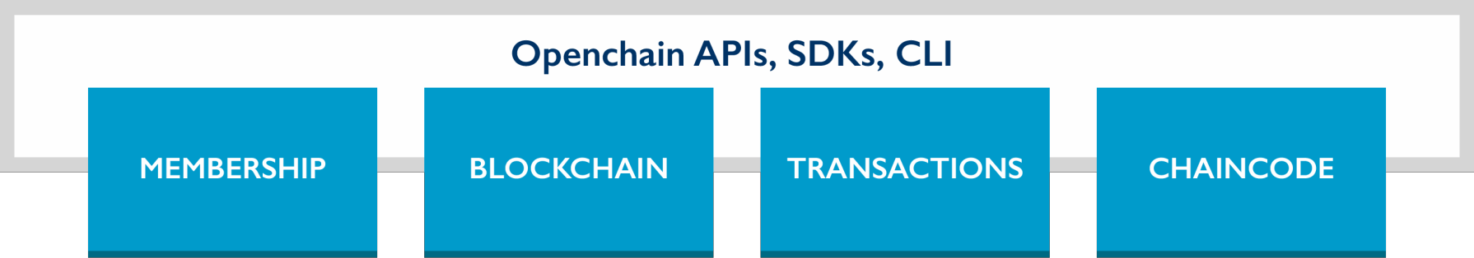
Application Programming Interface in Hyperledger
Includes the REST and JSON RPC APIs, events, and an SDK for applications to communicate with the network
Provides a set of CLIs to administer and manage the network
REST API and SDK are built on top of JSONRPC API
SDK is available in Golang, JavaScript, and Java
Additional programming languages can be added as necessary

Slide 23
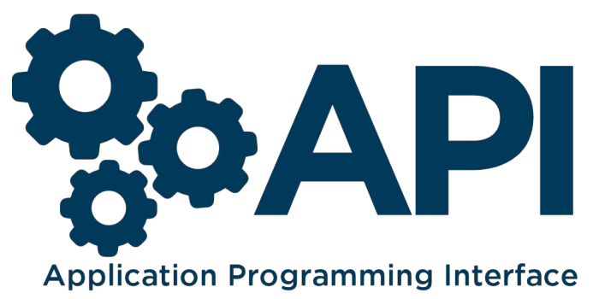
Application Programming Interface Categories
The API spans the following categories:
Identity: Enrollment to get certificates or revoke a certificate
Address: Target and source of a transaction
Transaction: Unit of execution on the ledger
Chaincode: Program running on the ledger
Blockchain: Content of the ledger
Network: Information about the blockchain network
Storage: External store for files or documents
Event: Sub/pub events on blockchain

Slide 24
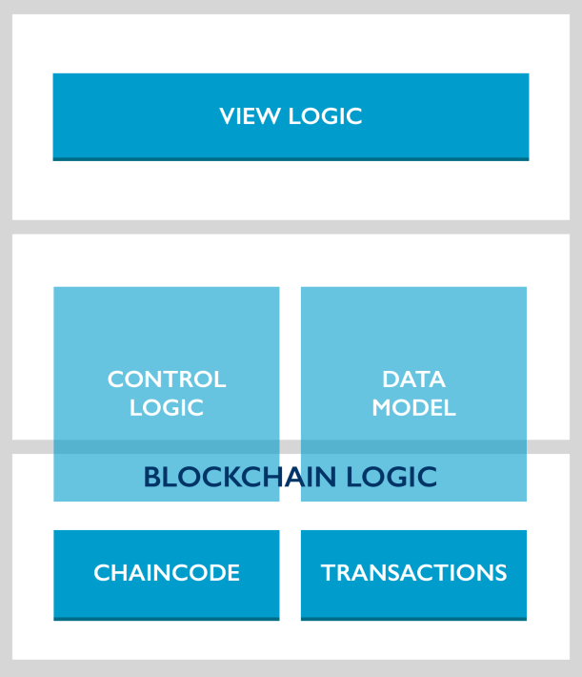
Application Model
An Hyperledger application follows a MVC-B architecture (Model View Control Blockchain)
VIEW LOGIC- Mobile or Web UI interacting with control logic
CONTROL LOGIC- Coordinates between UI, Data Model and Hyperledger APIs to drive transitions and chaincode
DATA MODEL- Manages offchain data, including documents and large files
Blockchain Logic- Are extensions of the Controller Logic and Data Model into the Blockchain realm

Slide 25
Network Topology
There are three potential deployment models:
Cloud hosted one network
Each participant owns a number of peer nodes, including validating nodes. Even though the network is in a cloud and hosted by a vendor who owns the physical hardware, the participants contractually control the computing resources, making the configuration decentralized within a centralized environment
01
02
Cloud hosted multiple networks
Cloud hosted multiple networks environment allows participants to have their peer nodes hosted by any cloud provider, given that peer nodes can connect to one another over HTTPs
₀₃ The Participant hosted intranet
Environment uses networks that are owned by the participants, with an HTTPs channel

Slide 26


Exploring Hyperledger Projects
The Linux Foundation’s
Hyperledger Project
Sawtooth Lake
Fabric
Burrow
Iroha
INDY

Slide 27



Iroha
The name Iroha is "the basics", "ABCs" or "the most basic element of all"
It is a distributed ledger project that was designed to be simple and easy to incorporate into infra-structural projects requiring D.L.T.
The goals of Iroha are:
01
Provide an environment for C++
developers to contribute to Hyperledger
02
Provide infrastructure for
mobile and web development
03
Provide a framework to experiment with
new APIs and consensus algorithms

Slide 28



Why Iroha?
Currently, the Hyperledger Project lacks an infrastructure project written in C++, thus limiting the potential developers who can contribute
There is not currently a strong focus on user interaction or mobile applications, though both are necessary for the realization of the widespread use of D.L.T.
Iroha aims to rectify both of these points, bringing in more developers while providing libraries for mobile user interface development
Modern, domain
driven, c++ design
Emphasis on mobile application development
New, chain-based Byzantine fault tolerant consensus algorithm, called Sumeragi
Simple construction

Slide 29











Hyperledger Fabric
Fabric, is a permissioned blockchain platform
01
02
Implemented in Go programming language
Made for enabling consortium blockchains with different degrees of permissions
03
Modular architecture delivering high degrees of confidentiality, resiliency, flexibility and scalability
04
Support pluggable implementations of different components and accommodate the complexity that exist across the economic ecosystem
05
Delivers a uniquely elastic and extensible architecture, distinguishing it from alternative blockchain solutions
06

Slide 30
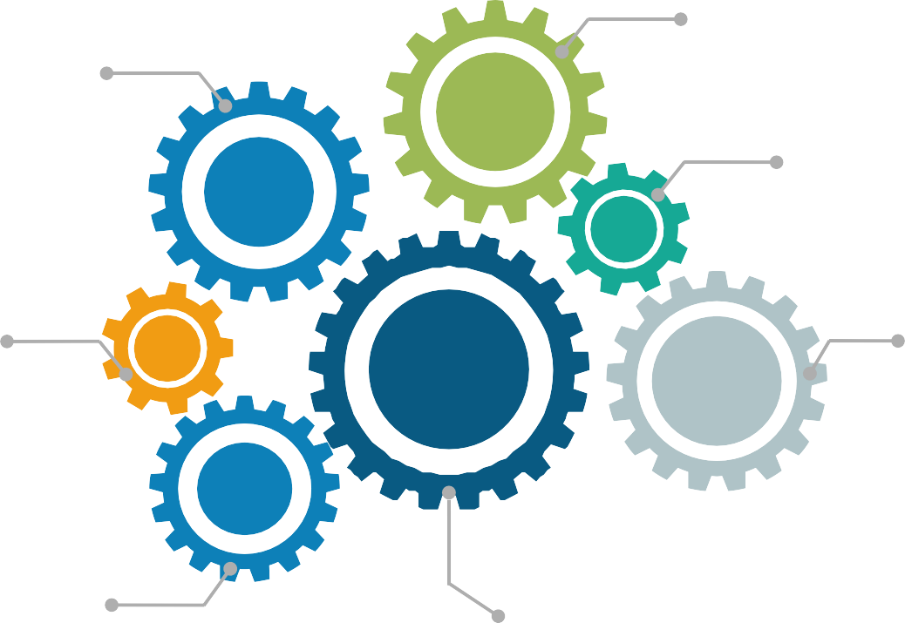
How Fabric Works?
Relies on a smart contract system (Chaincode), which every peer of the networks runs in Docker containers
Fabric issues transactions with derived certificates that are unlinkable to the owning participant
The events are structured as transactions and shared among the different participants
All participants must register
proof of identity to membership services in order to gain access to the system
The transactions are executed without a cryptocurrency
The content of each transaction is encrypted to ensure only the intended participants can see the content
All transactions are secured, private, and confidential. Fabric can only be updated by consensus of the peers

Slide 31



Sawtooth Lake
Designed to explore scalability, security, and privacy questions prompted by the original distributed ledgers
01
Maintains the security of the platform by allowing businesses to create private blockchains
02
It is additionally exceedingly modular. This empowers enterprises and consortia to settle on arrangement choices that they are best prepared to make
03
In Sawtooth, the data model and transaction language are implemented in a transaction family
04

Slide 32
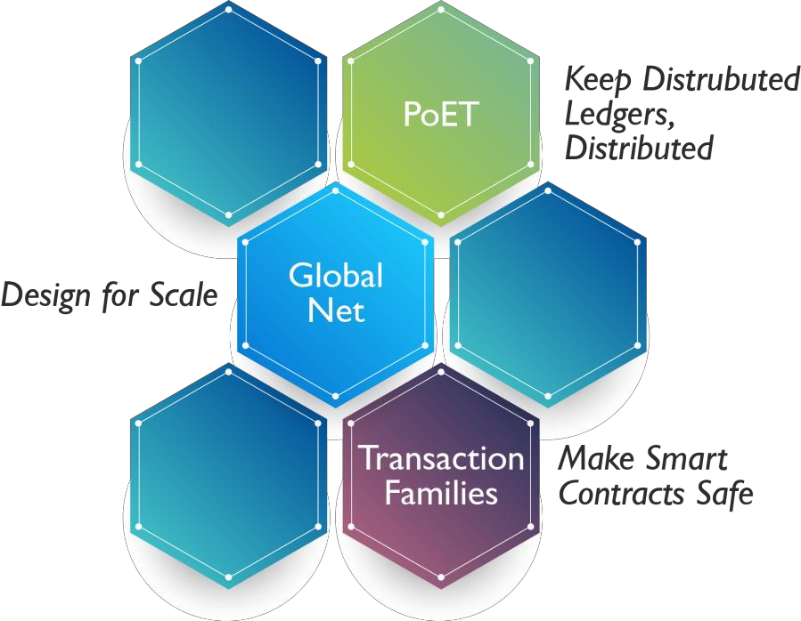
How is Sawtooth Lake Different?
Provides fair leader election across a large number of nodes without the computational race
Sawtooth users are able to define their own custom “transaction family” with data models and transaction languages tailored to their use case
Transaction Family Architecture provides a substrate for the implementation of diverse blockchain execution environments

Slide 33
Hyperledger Indy
Indy is all about giving identity owners
independent control of their personal data
and relationships
01 04
Indy shares three important virtues with the Internet: No one owns it. Everyone can use it. Anyone can improve it
Built so that the owner of the identity is structurally part of transactions made about
that identity
02
05
Validation is performed by a set of validator nodes running a modified, redundant Byzantine fault tolerant protocol called Plenum
Pairwise identifiers not only prevent correlation, but they stop third parties from transacting without the identity owner taking part
03
06
Plenum allows for the group of servers run by the validators to come to collective agreement about the validity and order of events

Slide 34

Hyperledger Burrow
01
Permissioned blockchain node that executes smart
contract code following the Ethereum specification
02
Burrow is built for a multi-chain universe with
application specific optimization in mind
03
Provides transaction finality and high transaction throughput
on a proof-of-stake Tendermint consensus engine
Burrow as a node is constructed out of three main components; the consensus engine, the permissioned Ethereum virtual machine and the rpc gateway
04

Slide 35
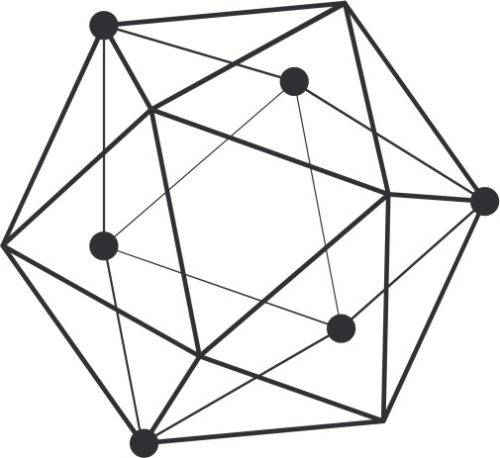









Hyperledger Tools
Hyperledger Cello
Hyperledger Composer
Aims to bring the on-demand “as-a- service” deployment model to the blockchain ecosystem to reduce the effort required for creating, managing and terminating blockchains
It is a collaboration tool for building blockchain business networks, accelerating the development of smart contracts and their deployment across a distributed ledger
Hyperledger Explorer
Can view, invoke, deploy or query blocks, transactions and associated data, network information, chain codes and transaction families, as well as any other relevant information stored in the ledger

Slide 36
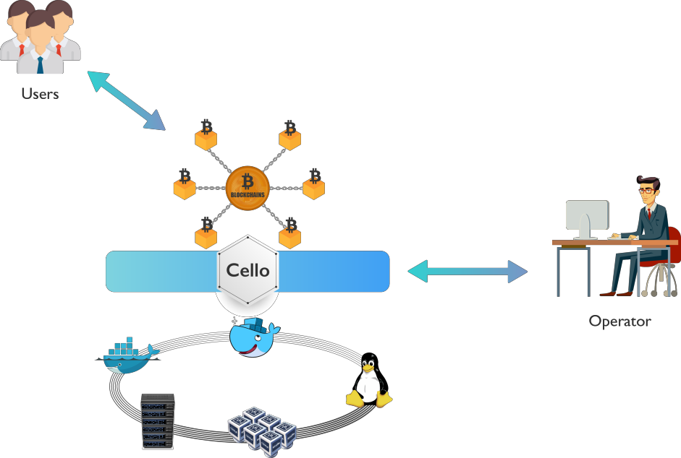
Hyperledger Cello
Hyperledger Cello is a blockchain provision and operation system, which helps manage blockchain networks
Using Cello, everyone can easily:
Build up a Blockchain as a Service (BaaS) platform
Provision customizable Blockchains instantly
Maintain a pool of running blockchain networks on
top of bare metals, Virtual Clouds, Container clusters
Check the system status, adjust the chain numbers, scale resources through dashboards
Extend with monitor, log, health and analytics features by employing additional components

Slide 37
Hyperledger Explorer
A blockchain module designed to create a user-friendly Web application
It was initially contributed by IBM, Intel and DTCC
Explorer is designed to create a user-friendly web application that can view, invoke, deploy, or query:
blocks
transactions and associated data
network information
chaincodes
transaction families
any other relevant information stored in the ledger

Slide 38
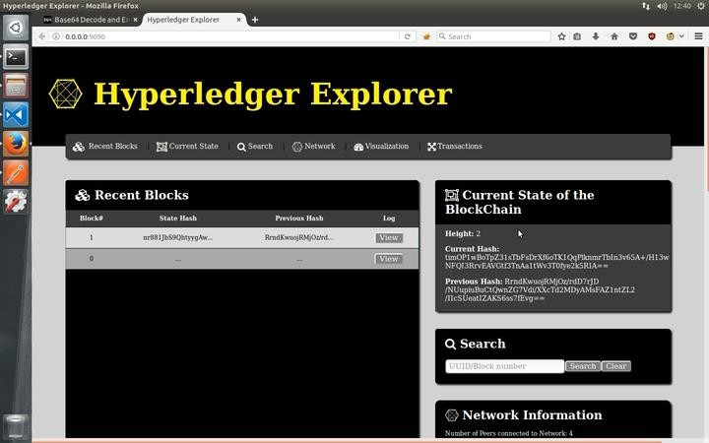
Hyperledger Explorer Window

Slide 39
Hyperledger Composer
An extensive, open development toolset and framework to make developing blockchain applications
easier
It accelerate time to value, and make it easier to integrate your blockchain applications with the existing
business systems
Allows you to model your business network and integrate existing systems and data with your
blockchain applications
Applications use business centric APIs to invoke transactions that create, delete, and update assets and
transfer them between participants
Assets, participants and transactions are recorded in the worlds state in registries

Slide 40
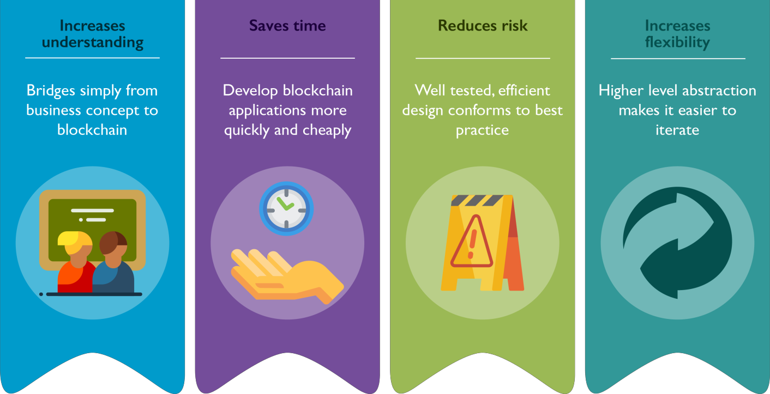
Benefits of Hyperledger Composer

Slide 41
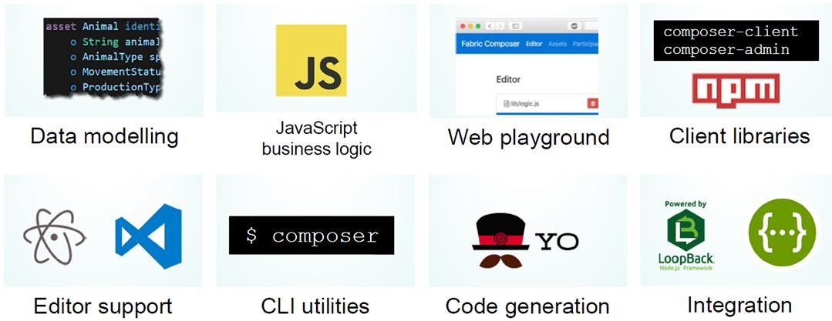
Extensive Familiar Open Development Toolset
In addition, Fabric Composer is designed with underlying technology stack familiar to open-source developers:
Business logic is implemented in JavaScript
There are client libraries for Node.js (npm) and editor plugins for Atom and Visual Studio
It has a CLI to deploy and manage business networks and perform other operations from the API
It has code generation and there are tools built using Yeoman that enable users to generate an application using a deployed business network definition
It has integration support for such standards as LoopBack and Swagger for defining REST APIs

Slide 42
Key Development Concepts
Model files describe the assets, participants, transactions, and events that exist in a business network
Expressive modelling language includes relationships, arrays, and validation rules
Data serialized as JSON, and is fully validated by the Hyperledger Composer runtime
Access control lists define rules for sharing and privacy
Rules are automatically enforced by the Hyperledger Composer runtime
Transaction processor functions implement additional business requirements
Standard JavaScript code executed on the Blockchain by the Hyperledger Composer runtime
A business network definition is the set of the above for a given business network

Slide 43
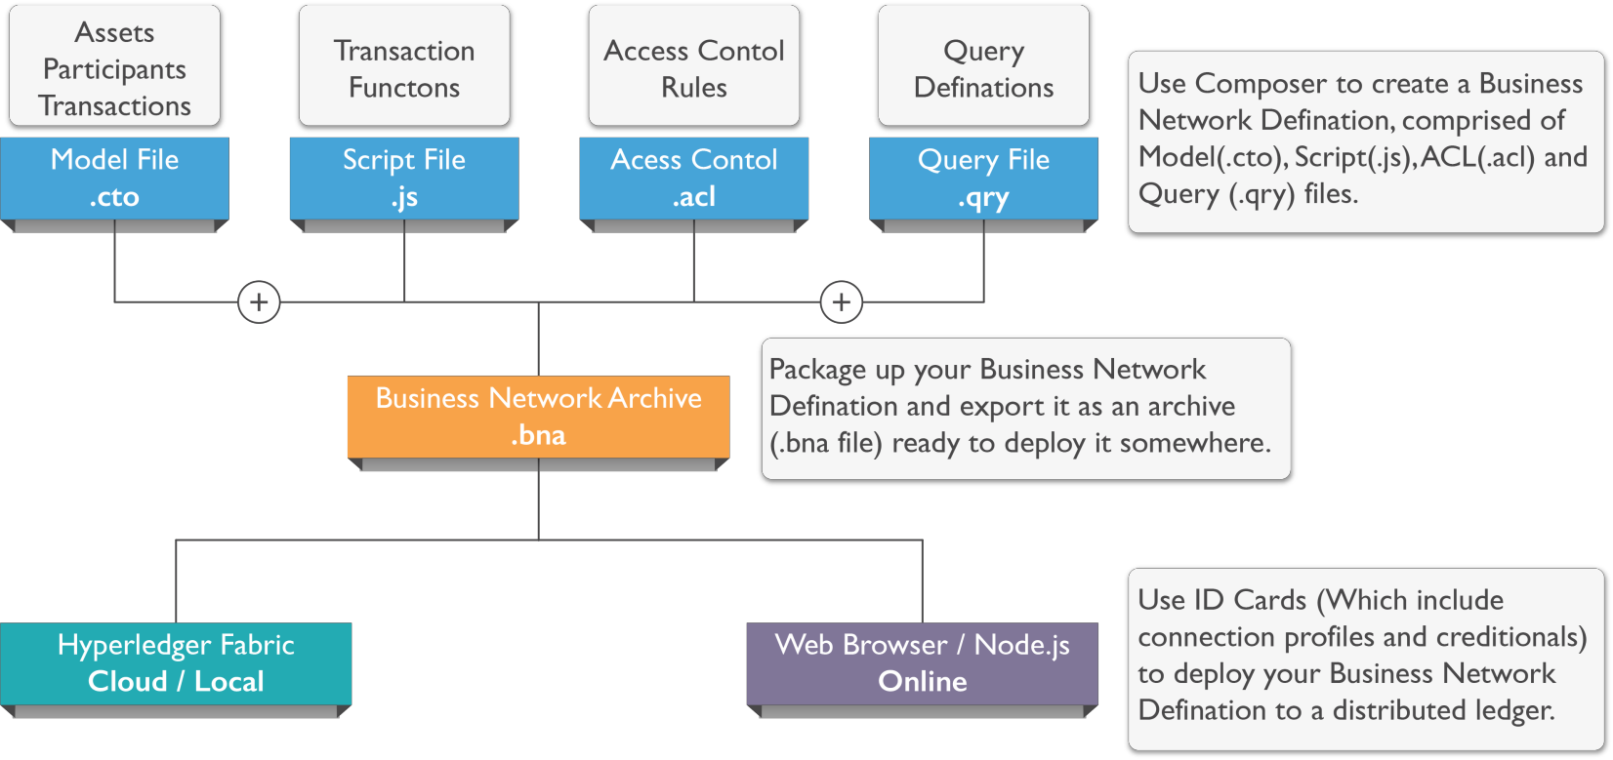
Business Model Archive

Slide 44
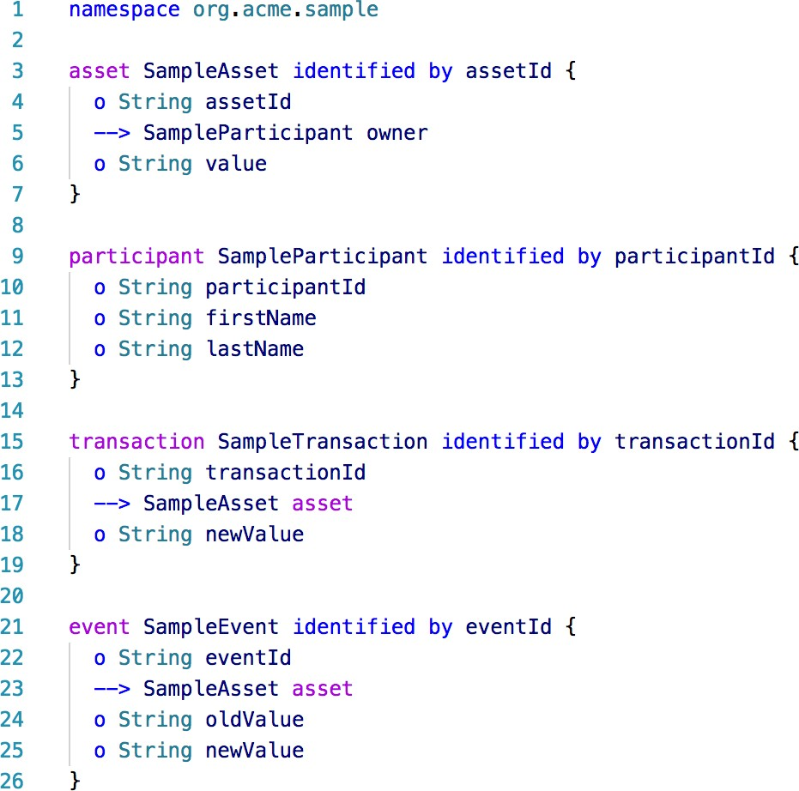
Model Files
Namespaces group related types
Specific keywords for defining assets, participants,
transactions, and events in a business network
Non-abstract types must have an identifying field
Types have a set of properties, denoted with a
leading ”o”
Types can have relationships to other types,
denoted with a leading ”-->”

Slide 45
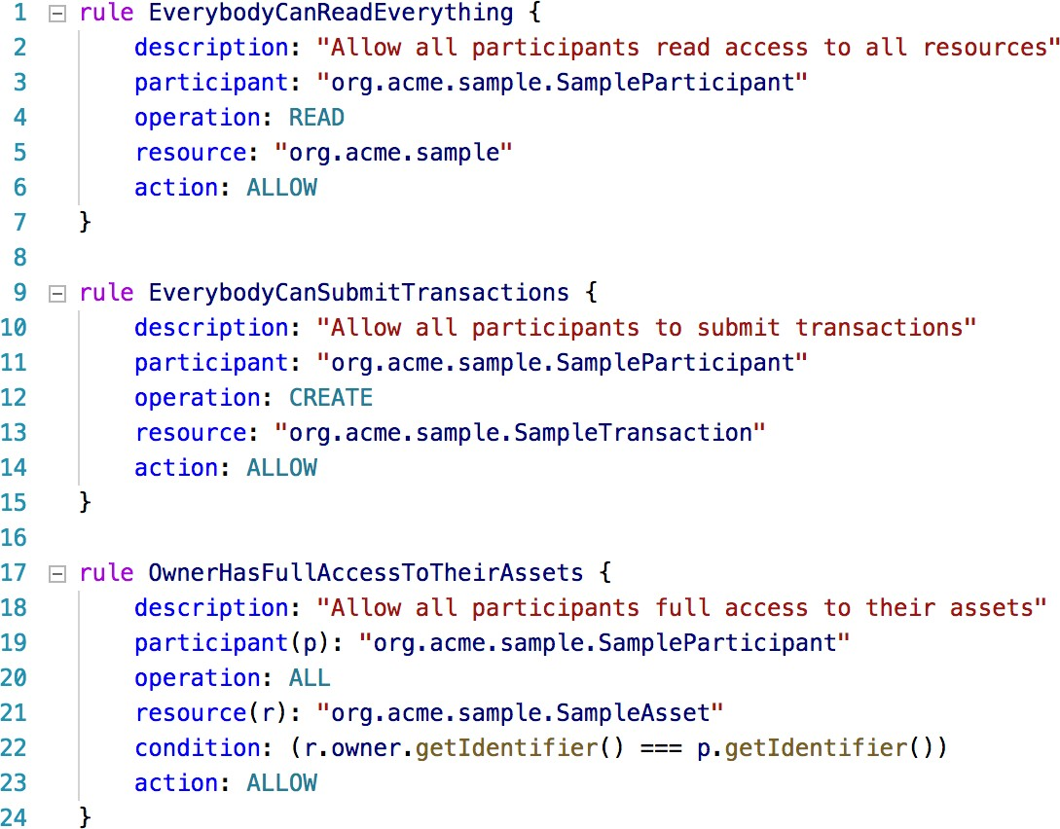
Access Control Lists
Rules are executed in order from top to bottom. If no rule permits access, then access is denied
Each rule permits or denies permission to a participant to perform an operation on a resource. Resources are assets, participants, etc
Rules can contain complex conditions. Conditions are written in JavaScript, and can access the participant and resource

Slide 46
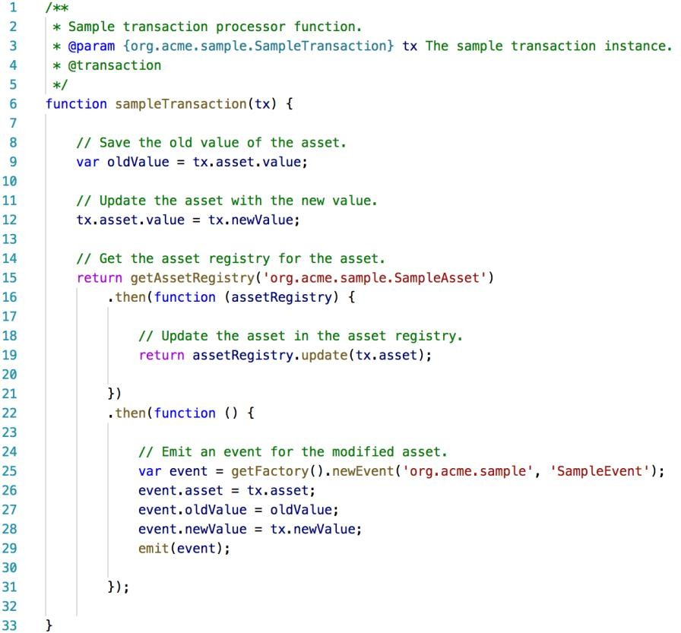
Transaction Processor Functions
Transaction processor functions are written in standard JavaScript (ES5) and they can use the runtime API to interact with the Blockchain
Annotations in the comments define the transaction that the function accepts, and that the function is
a transaction processor function
Transaction processor functions are atomic; all of the updates are applied, or no updates are applied
Interact with the registry APIs to add, update, and remove assets stored on the Blockchain in the world state
Use the event APIs to publish events to external applications for notifications and triggering downstream processing

Slide 47

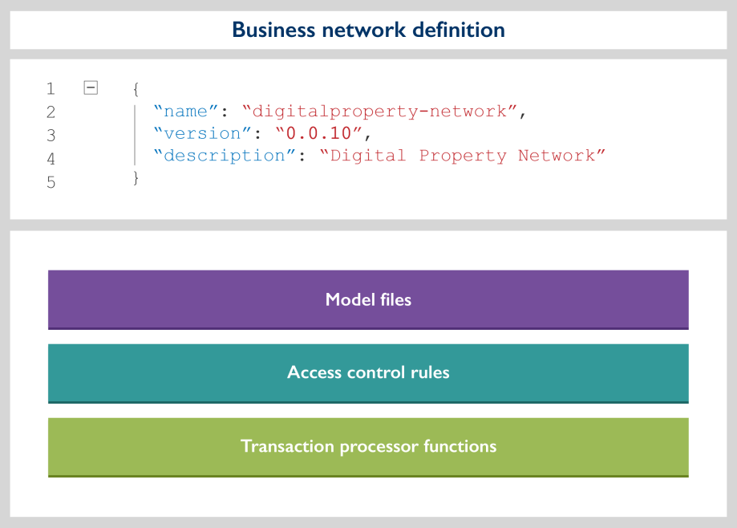
Business Network Definition
Each business network definition has metadata associated with it – at least a name and version
The metadata is stored in a package.json file. Each business network definition is a npm module
The business network definition contains all of the model files, access control rules, and transaction processor functions for a business network

Slide 48

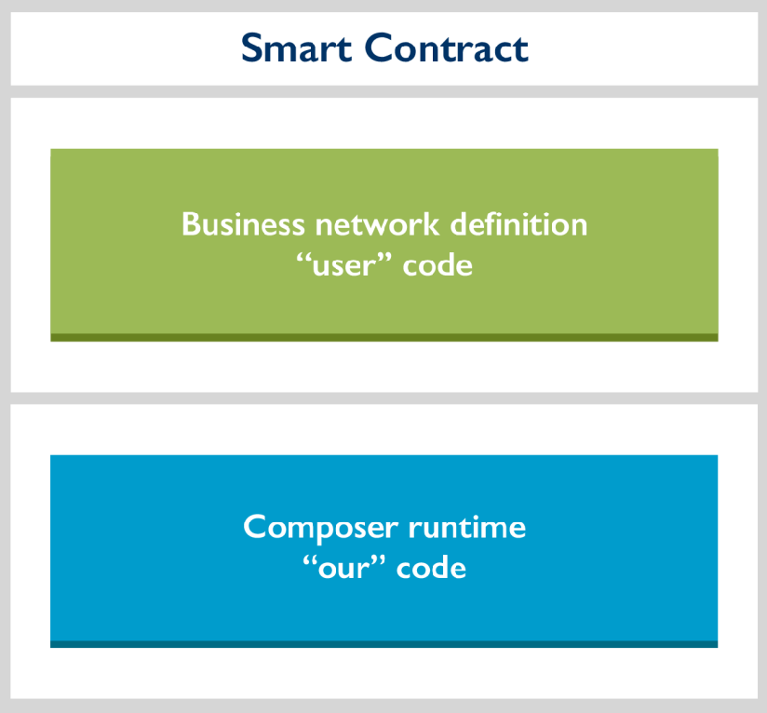
Business Network Deployment
Business network definitions can be deployed to a Blockchain platform, for example Hyperledger Fabric v0.6 or v1.0
The business network definition is not compiled or translated into smart contract code, for example Composer does not convert JavaScript transaction processor functions into Go code
Composer has a runtime which understands, manages, and executes the business network definition
The business network definition and Composer runtime are deployed together as the smart contract

Slide 49

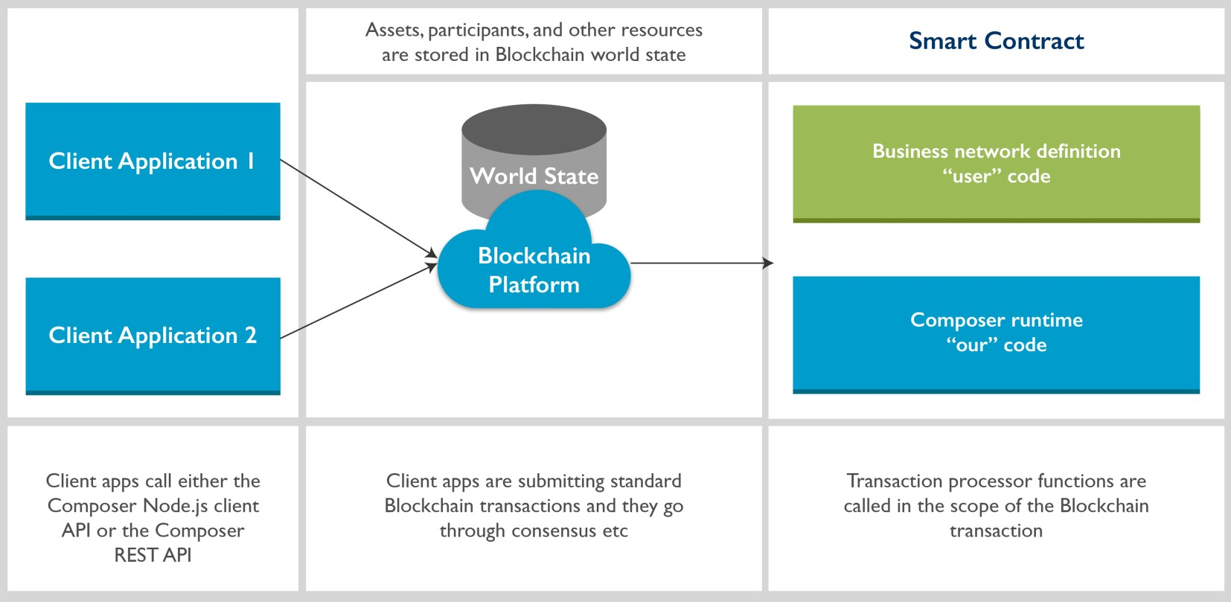
Business Network Execution

Slide 50
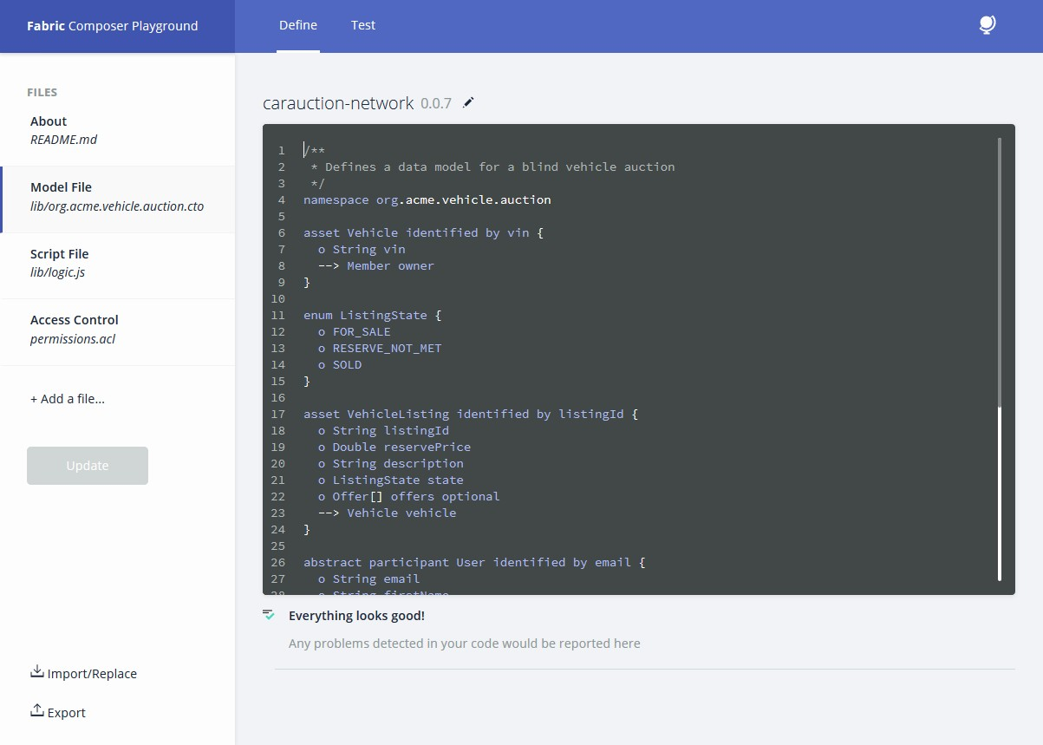
Modelling Business Networks: Composer Playground
An interactive web tool for the development (and test) of business networks without installing anything

Slide 51
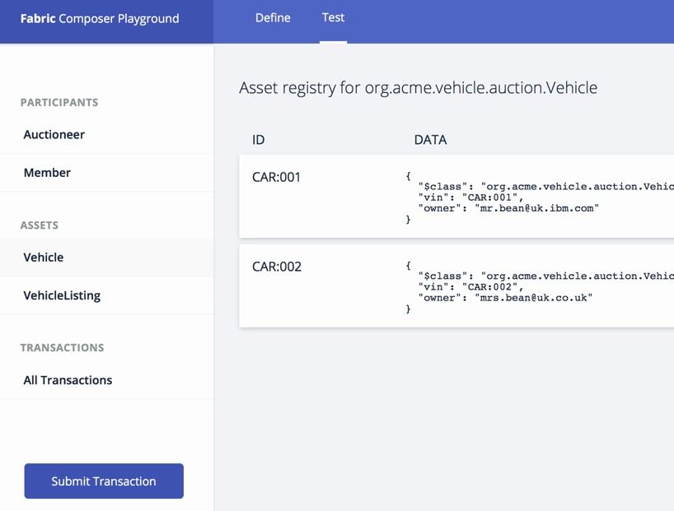
Test Business Networks: Composer Playground
Test tab on playground
Dynamically reflects defined model
Creates default registries
Create, read, update, and delete resources interactively
Submit transactions interactively
Fabric and browser-only modes
Multiple environments, e.g. test, prod

Slide 52

In this step by step tutorial we’ll be setting up a business network, defining our assets, participants and transactions, and testing our network by creating some participants and an asset, and submitting transactions to change the ownership of the asset from one to another

Slide 53
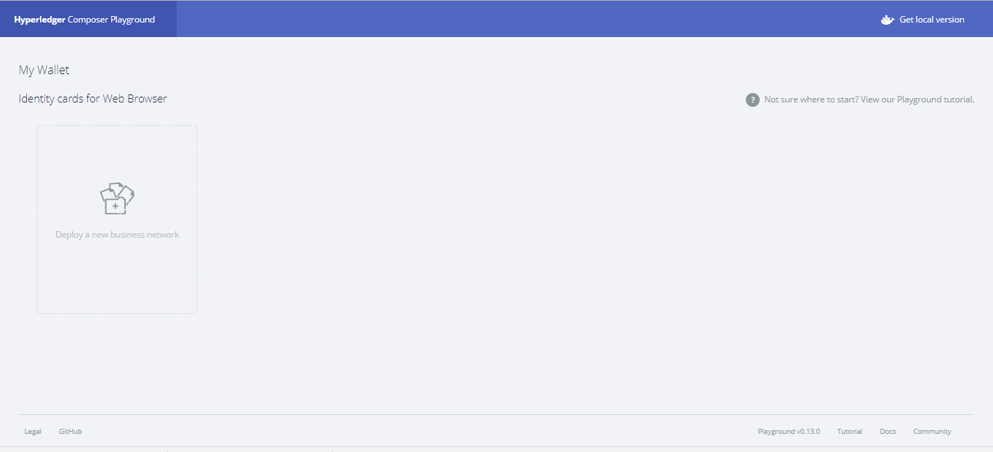
Step One: Open the Hyperledger Composer Playground
Open Composer Playground. You should see the My Wallet screen

Slide 54
Step Two: Creating a New Business Network
Next, we want to create a new business network from scratch
A business network has a couple of defining properties; a name, and an optional description. (You can also
choose to base a new business network on an existing template, or import your own template)
Follow these steps:
Click Deploy a new business network under the Web Profile heading to get started.
The new business network needs a name, let's call it new-network
Optionally, you can put in a network description.
Next we must select a business network to base ours on, because we want to build the network from scratch, click empty-business-network

Slide 55
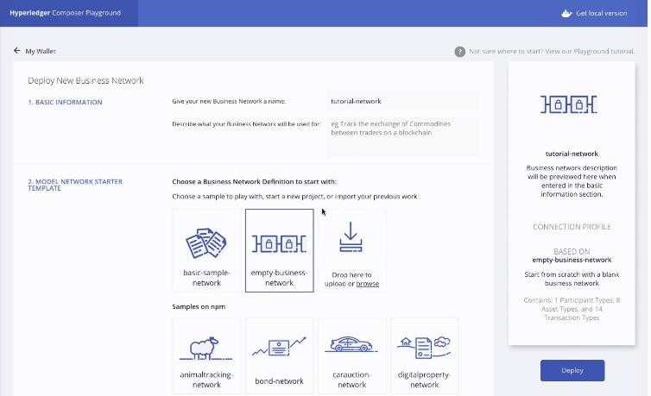
Choosing a Business Network Definition
To start with choose a Business Network definition from the given options
Since we are creating our own business, select empty business network from the options

Slide 56
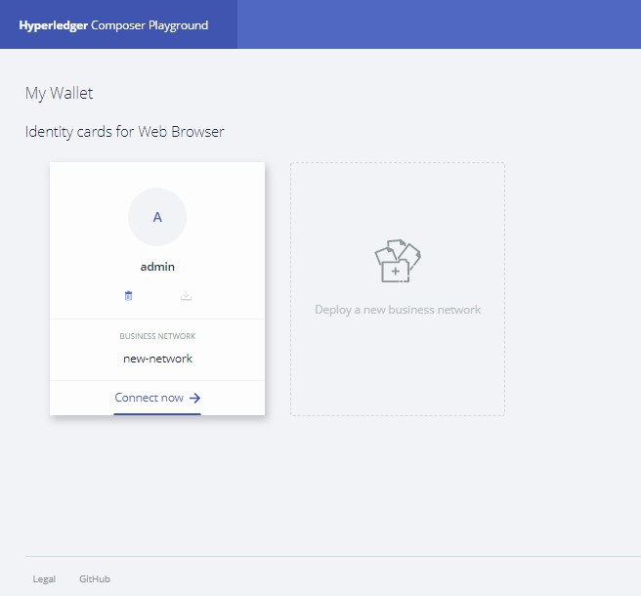
Step Three: Connecting to the Business Network
Now that we've created and deployed the business network, you should see a new ID card called admin for our business network new-network in your wallet
When connecting to an external blockchain, ID cards represent everything necessary to connect to a business network. They include connection details, authentication material, and metadata
To connect to our business network click Connect
now under our ID card

Slide 57
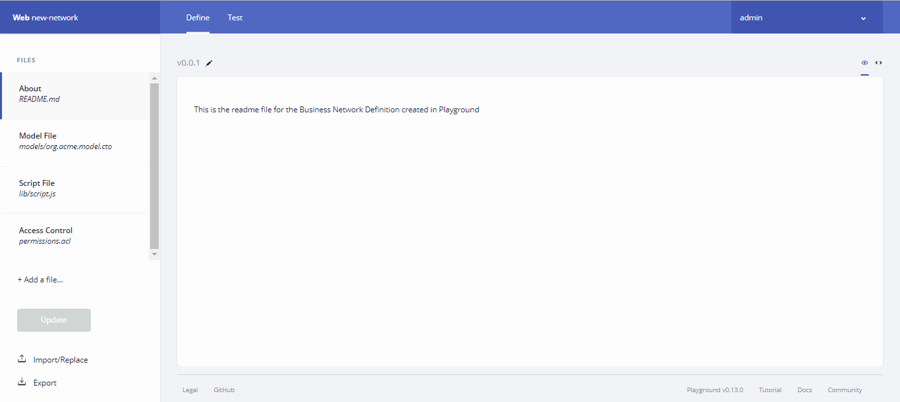
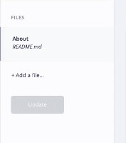
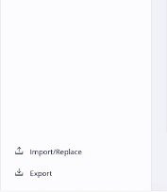
Adding Files to Make up a Business Network Definition
Click here to create and
edit the files

Slide 58
Step Four: Adding a Model File
As you can see, we're in the Define tab right now, this tab is where you create and edit the files that make up a business network definition
As we selected an empty business network template, we need to define our business network files
The first step is to add a Model file. Model files define the assets, participants, transactions, and events in our business network
Click the Add a file button.
Click the Model file and click Add.
Delete the lines of code in the model file and replace it with this: description o String mainExchange o
/** * My commodity trading network */ namespace org.acme.mynetwork asset Commodity identified by tradingSymbol {
o String tradingSymbol o String
Double quantity --> Trader owner } participant Trader identified by tradeId
{ o String tradeId o String firstName o String lastName } transaction Trade { --
> Commodity commodity --> Trader newOwner }
This domain model defines a single asset
type Commodity and single participant type Trader and a single transaction type Trade that is used to modify the owner of a commodity.

Slide 59
Step Five: Adding a Transaction Processor Script file
Now that the domain model has been defined, we can define the transaction logic for the business network
– These functions are automatically executed
when a transaction is submitted for processing
Click the Add a file button.
Click the Script file and click Add.
Delete the lines of code in the script file and replace it with the following code:
/**
* Track the trade of a commodity from
one trader to another
@param {org.acme.mynetwork.Trade} trade
- the trade to be processed @transaction */
function tradeCommodity(trade) { trade.commodity.owner = trade.newOwner; return getAssetRegistry('org.acme.mynetwork.Com modity') .then(function (assetRegistry)
{ return
assetRegistry.update(trade.commodity);
}); }

Slide 60
Step Six: Adding an Access Control File
Access Control files define the access control rules for business networks. (While you can have multiple model or script files, you can only have one access control file in any business network)
Click the Add a file button
Click the Access Control file and click Add
Delete the lines of code in the access control file and replace it with the following code:
/** * Access control rules for mynetwork */ rule Default { description: "Allow all participants access to all resources" participant: "ANY" operation: ALL resource: "org.acme.mynetwork.*" action: ALLOW } rule SystemACL { description: "System ACL to permit all access" participant: "org.hyperledger.composer.system.Participant" operation: ALL resource: "org.hyperledger.composer.system.**" action: ALLOW }
This access control rule allows all participants to access all business network resources, and allows all users to have system access control privileges

Slide 61
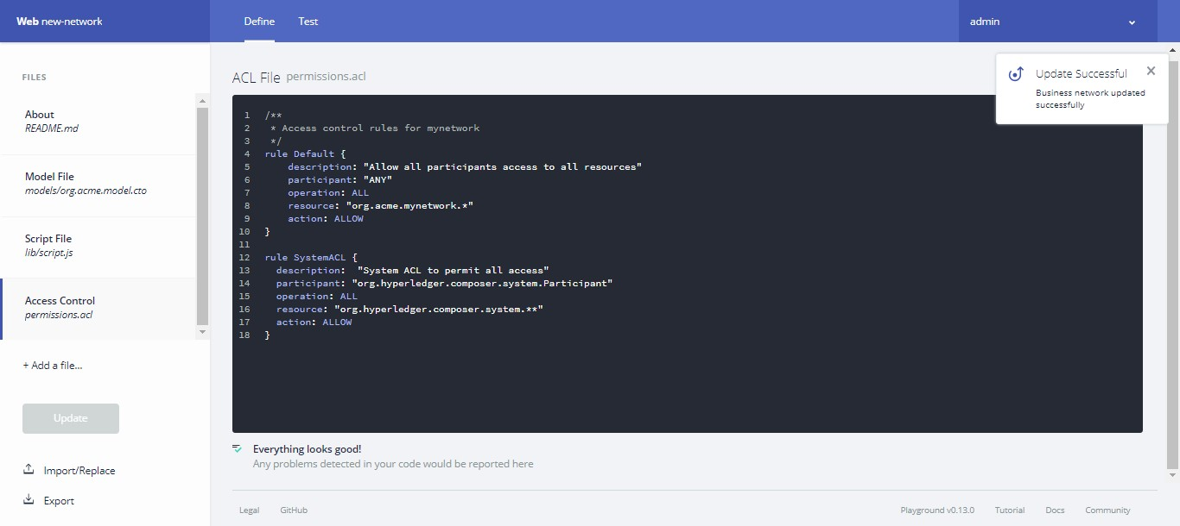
Step Seven: Deploying the Updated Business Network
Now that we've created our model, script, and access control files, we need to deploy and test our business network
Click Update to deploy our new model, script, and access control files

Slide 62
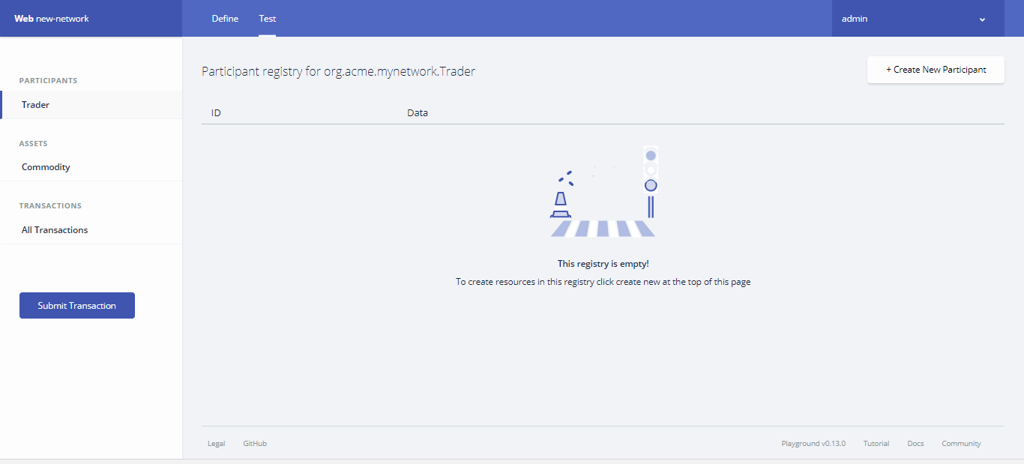
Step Eight: Testing the Business Network Definition
Next, we need to test our business network by creating some participants (in this case Traders), creating an asset (a Commodity), and then using our Trade transaction to change the ownership of the Commodity
Click the Test tab to get started

Slide 63
Step Nine: Creating Participants
The first thing we should add to our business network is two participants. (Ensure that you have the Trader tab selected on the left, and click Create New Participant in the upper right)
What you can see is the data structure of a Trader participant. We want some easily recognizable data, so
delete the code that's there and paste the following:
{ "$class": "org.acme.mynetwork.Trader", "tradeId": "TRADER1", "firstName": "Jenny", "lastName": "Jones" }
Click Create New to create the participant
You should be able to see the new Trader participant you've created. We need another Trader to test
our Trade transaction though, so create another Trader, but this time, use the following data:
{ "$class": "org.acme.mynetwork.Trader", "tradeId": "TRADER2", "firstName": "Amy", "lastName": "Williams" }
Make sure that both participants exist in the Trader view before moving on!

Slide 64
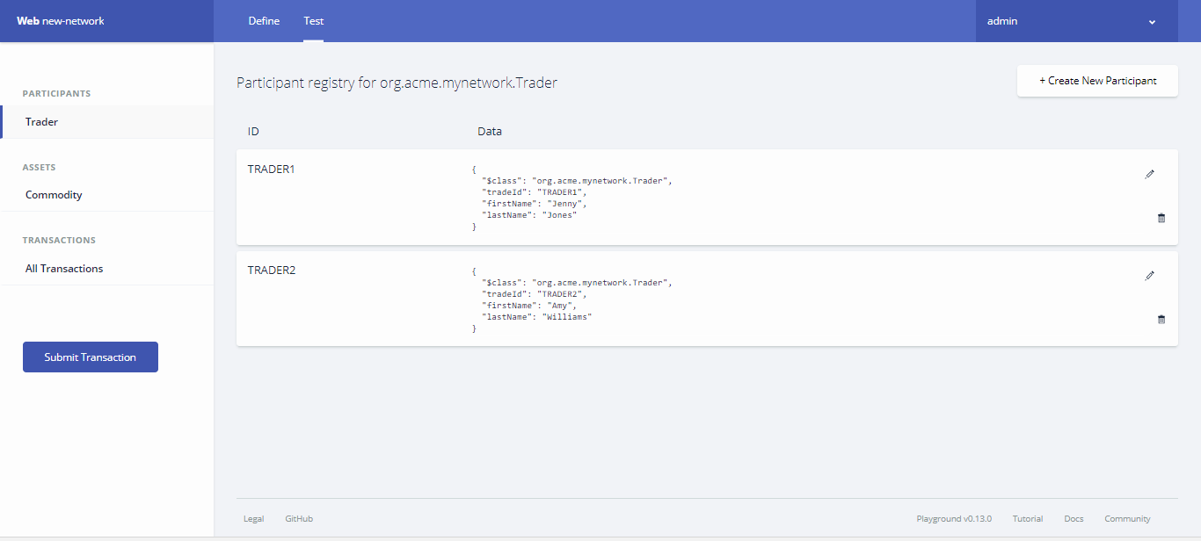
Two Participants Created: TRADER1, TRADER2
Two participants:
TRADER1, TRADER2

Slide 65
Step Ten: Creating an Asset
Now that we have two Trader participants, we need something for them to trade. Creating an asset is very similar to creating a participant. The Commodity we're creating will have an owner property indicating that it belongs to the Trader with the tradeId of TRADER1
Click the Commodity tab under Assets and click Create New Asset.
Delete the asset data and replace it with the following:
{
"$class": "org.acme.mynetwork.Commodity",
"tradingSymbol": "ABC", "description": "Test commodity", "mainExchange": "Euronext", "quantity": 72.297,
"owner": "resource:org.acme.mynetwork.Trader#TRADER1 "
}

Slide 66
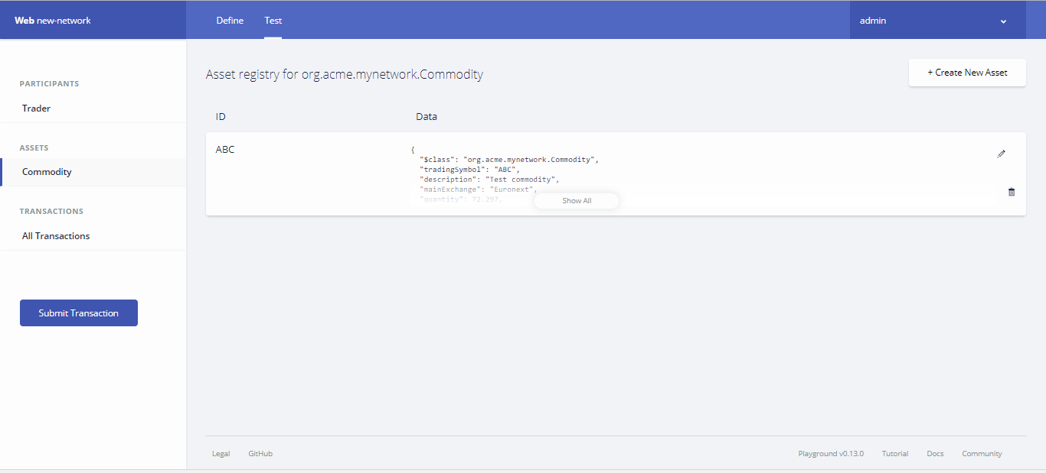
Asset Created

Slide 67
Step Eleven: Transferring the Commodity
Now that we have two Traders and a Commodity to trade between them, we can test our Trade transaction To test the Trade transaction:
Click the Submit Transaction button on the left
Ensure that the transaction type is Trade
Replace the transaction data with the following
{
"$class": "org.acme.mynetwork.Trade", "commodity": "resource:org.acme.mynetwork.Commodity#ABC", "newOwner": "resource:org.acme.mynetwork.Trader#TRADER2"
}
Click Submit

Slide 68
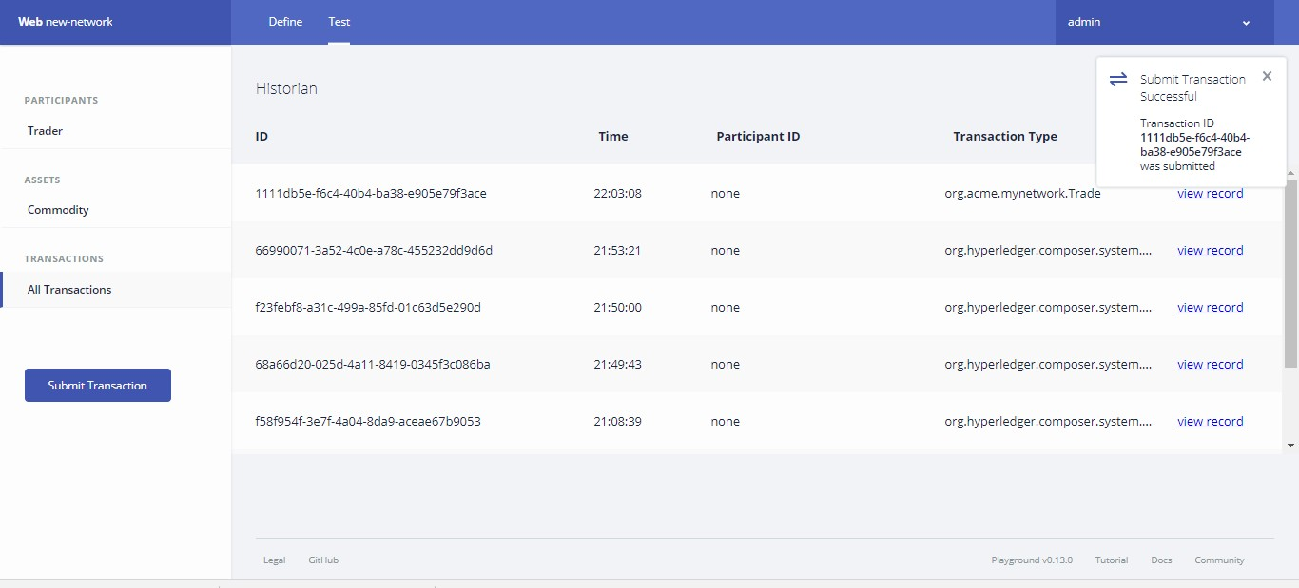
Submit Transaction Successful

Slide 69
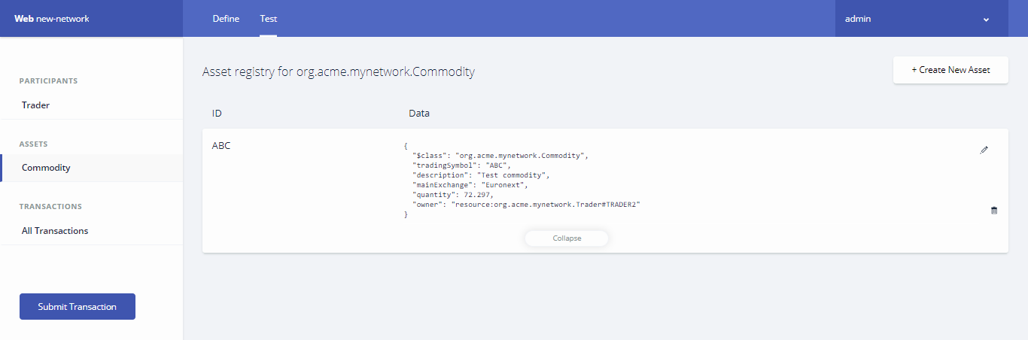
Change in Ownership
To check that our asset has changed ownership from TRADER1 to TRADER2, click the Commodity tab, and expand the data section for the asset. You should see that the owner is listed as: resource:org.acme.mynetwork.Trader#TRADER2

Slide 70
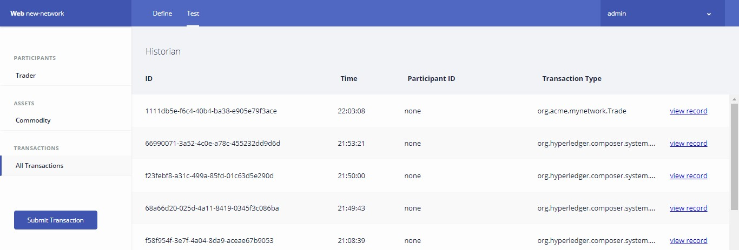
To Check all Transactions
To view the full transaction history of our business network, click All Transactions on the left
You can see that certain actions we performed using the UI, like creating the Trader participants and
the Commodity asset, are recorded as transactions, even though they're not defined as transactions in our business network model. These transactions are known as 'System Transactions' and are common to all business networks, and defined in the Hyperledger Composer Runtime

Slide 71
Now that you have learnt to use the Composer Playground. You can now test and deploy your own business network !!

Slide 72


Copyright © 2017, edureka and/or its affiliates. All rights reserved.

Slide 73
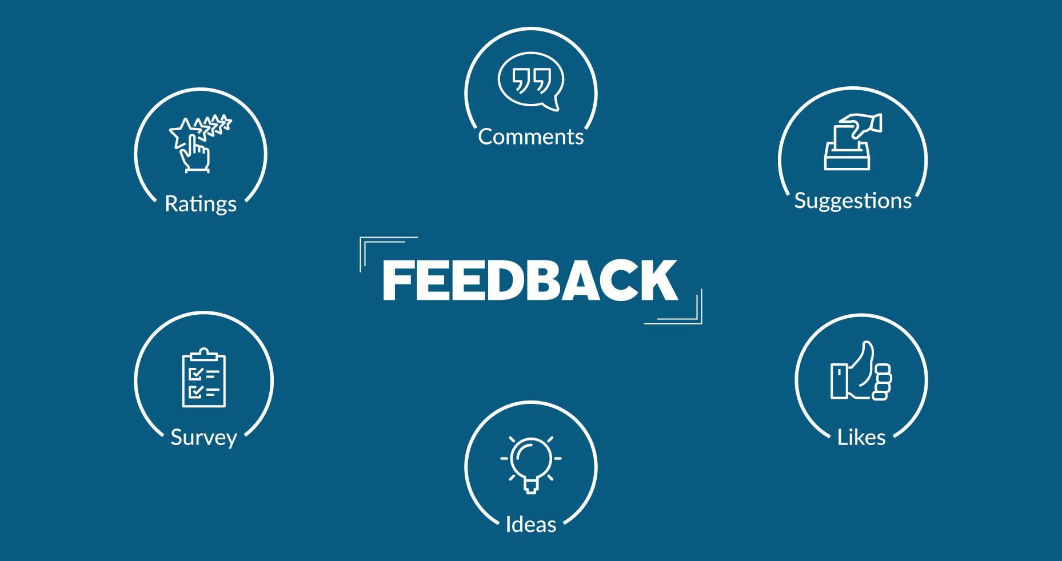
Copyright © 2017, edureka and/or its affiliates. All rights reserved.

Slide 74


